Slide 1
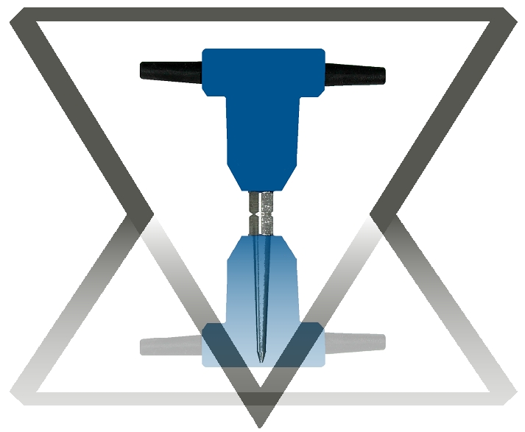
Offset Geometry Preplanning
Seismic
Acquisition
Consultants, Inc.
115 Walton Rd.
Etoile, TX 75944
www.seismicacquisition.com
blseismicqc@gmail.com
713-408-8695
Attn: Bruce Lindsey
The most expensive data is poor data or data of insufficient quality to resolve the objectives.

Slide 2

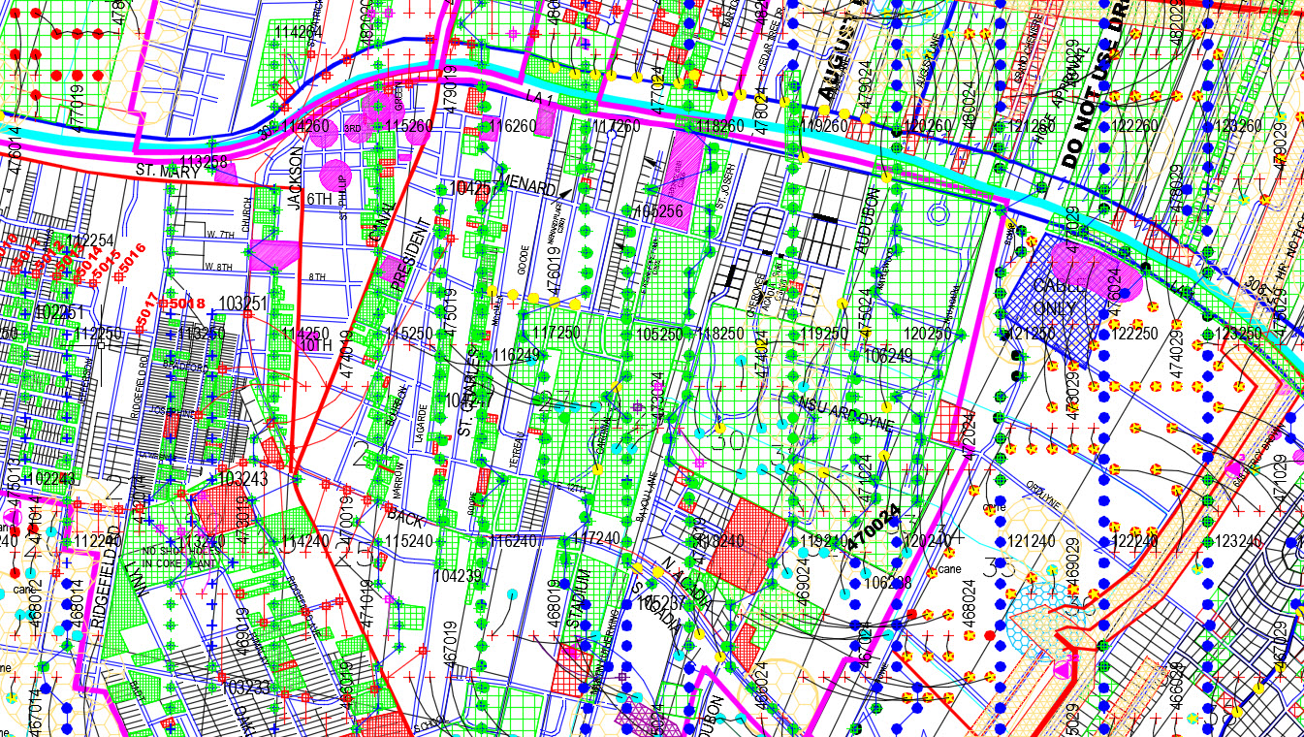
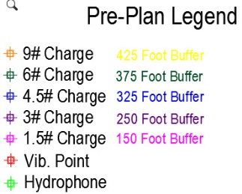
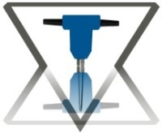
2002 Vintage City of Thibodaux
Preplan and post plot map using combined sources and receivers; variable
charge sizes, vibroseis, p-wave phones and hydrophones deployed in drill holes.

Slide 3
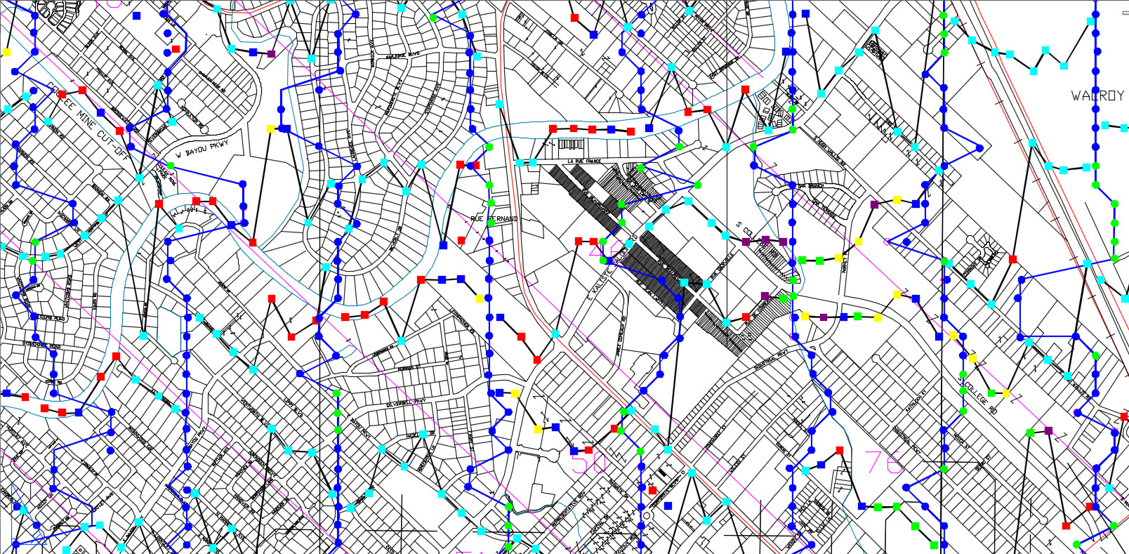
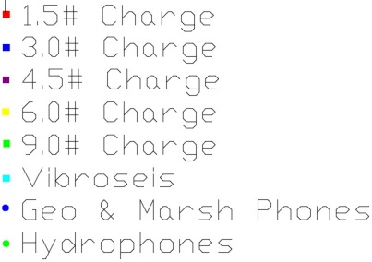
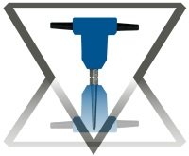
2003 Lafayette Preplan Survey Results
Post plot map using combined sources and receivers; variable charge sizes,
vibroseis, p-wave phones and hydrophones deployed in drill holes.

Slide 4
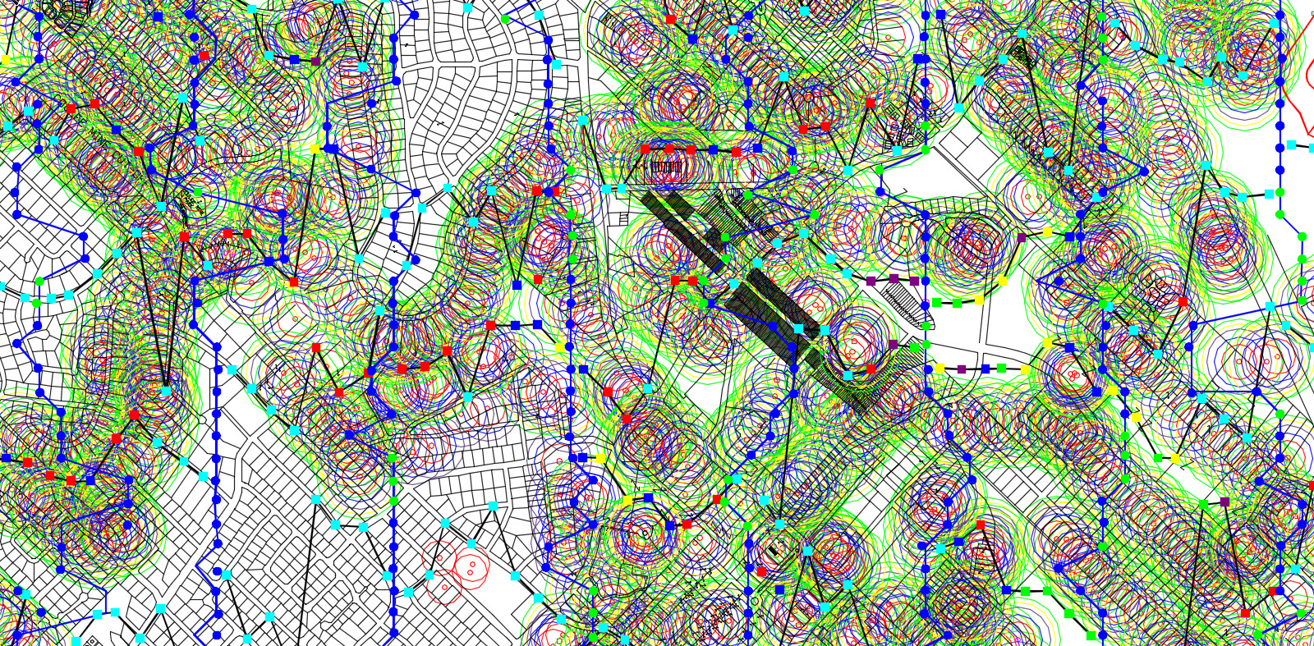

2003 Lafayette Post Plot & Buffers
Ugly buffering method of the time demonstrates sampling of project obstacles.

Slide 5
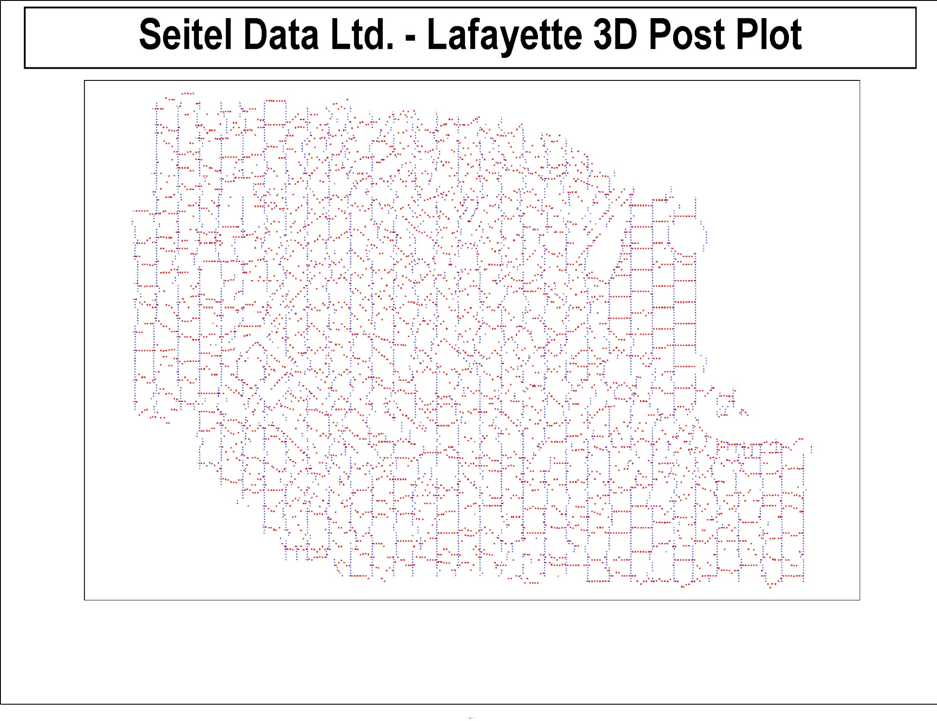
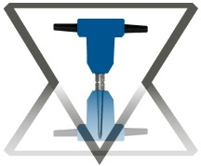
The Lafayette survey geometry was randomized by necessity in the city portion of the project, significantly eliminating acquisition footprint, while retaining beneficial sampling as indicated by the following fold plots.

Slide 6
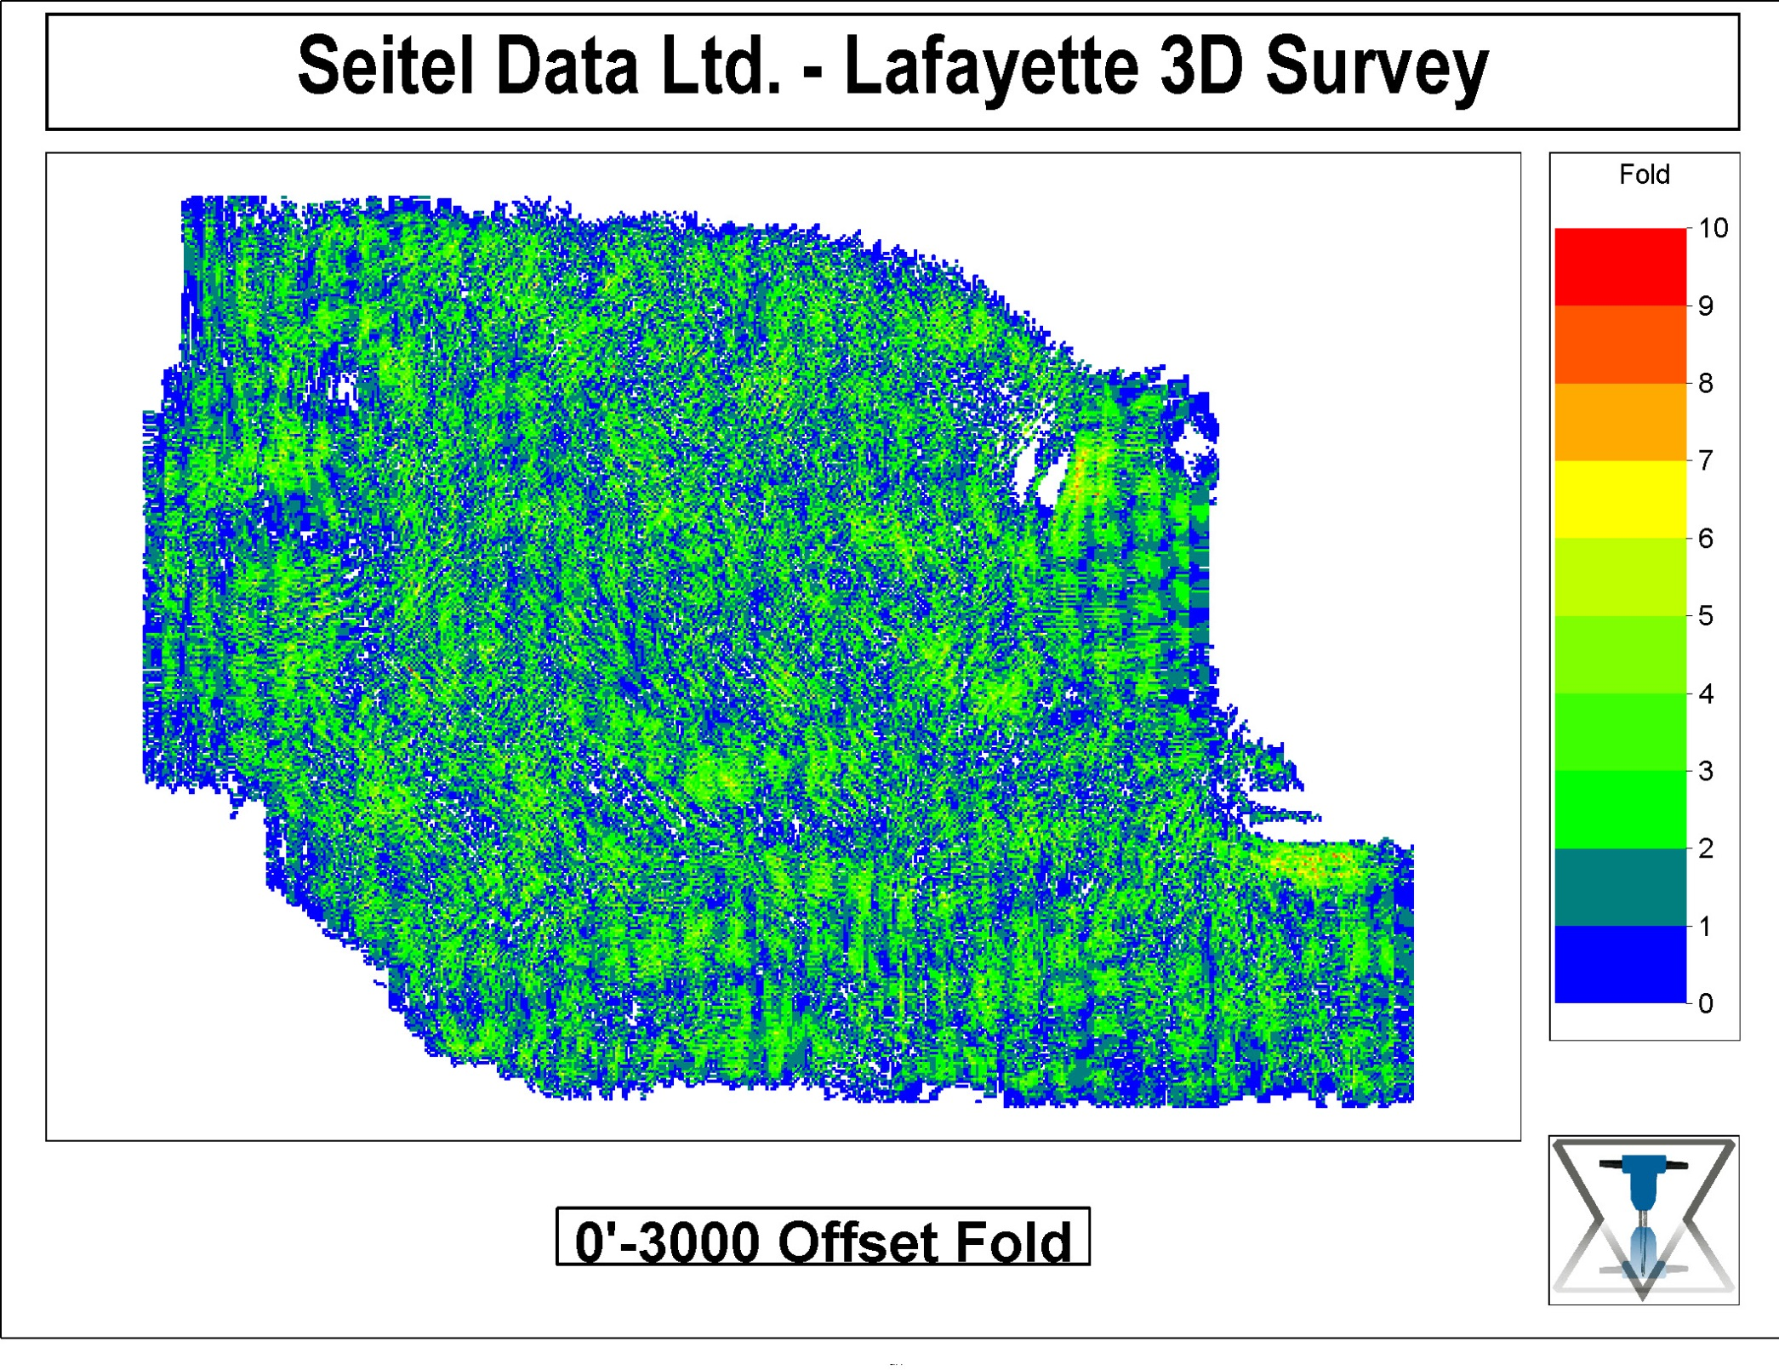

Slide 7
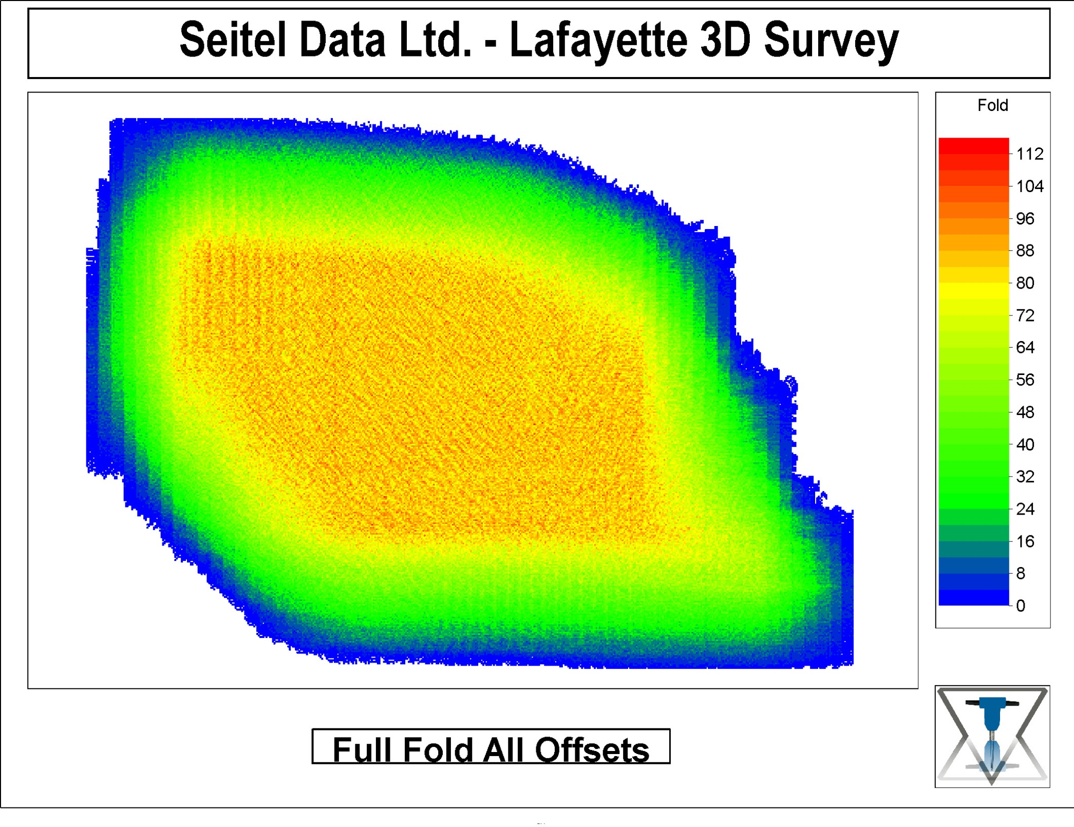

Slide 8
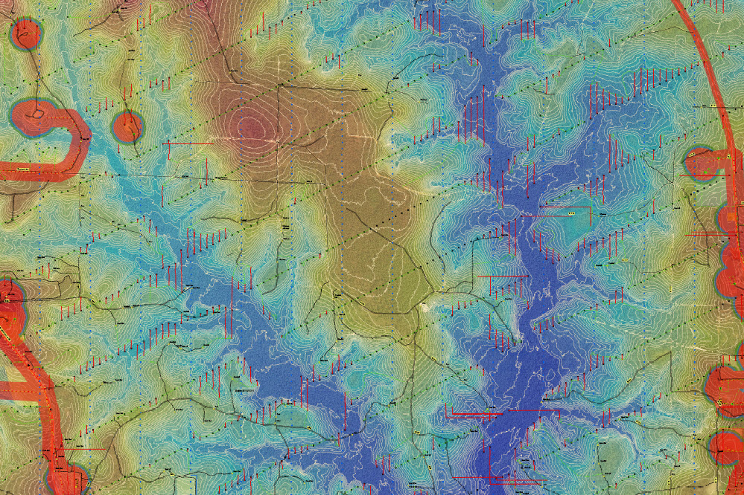
2012 Environmentally Sensitive Preplan
The above map displays an initial preplan using LiDAR, aerial photography
and limited hazard surveying, combined with field scouting to help establish
reference analogs for image components. See the following survey post plot.

Slide 9
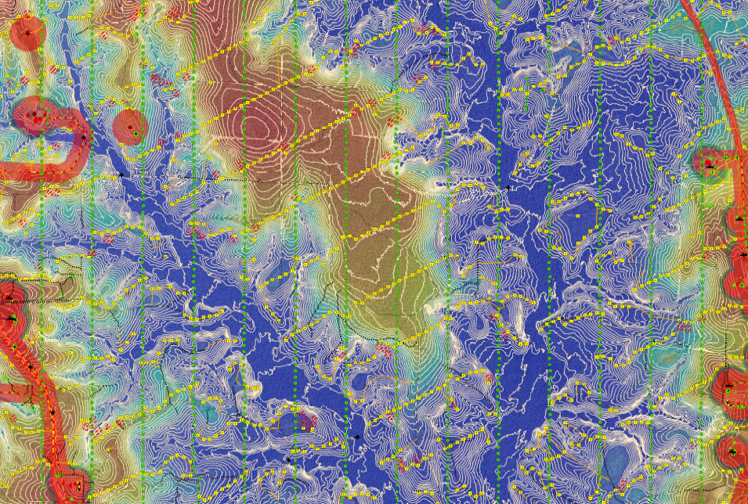
2012 Environmentally Sensitive Post Plot
This map displays the survey post plot resulting from the preplan shown in
the slide above, which preplan was adjusted through several iterations .

Slide 10
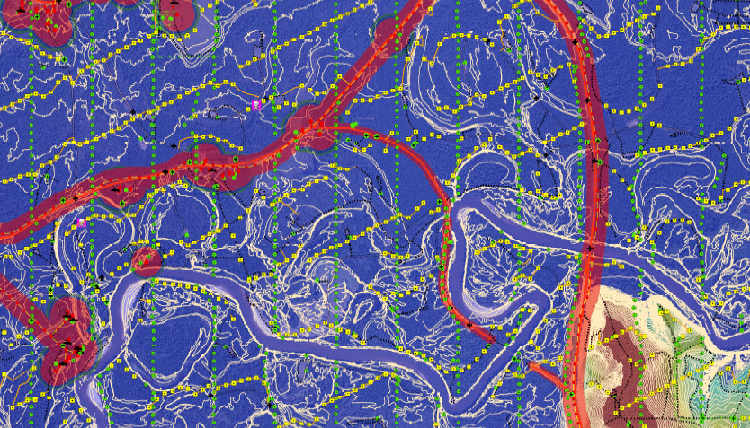
2012 River Bottom Preplan Results
The preplan resulting in the above point placements used a combination of LiDAR
and high quality aerial photography. Elevation contours from Lidar are at 3’ intervals,
necessary for discerning location adjustments for significant wetlands limitations.

Slide 11
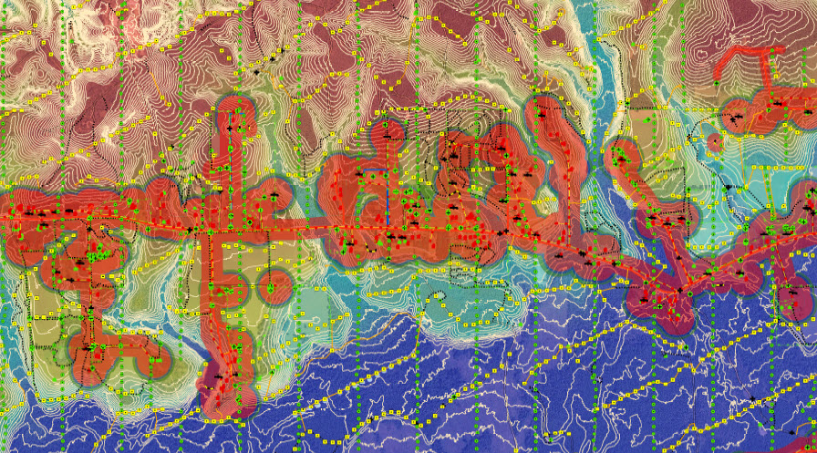
2012 Modest Culture Post Plot
The above map demonstrates post plot positioning in and around culture resulting
from detailed preplanning.

Slide 12
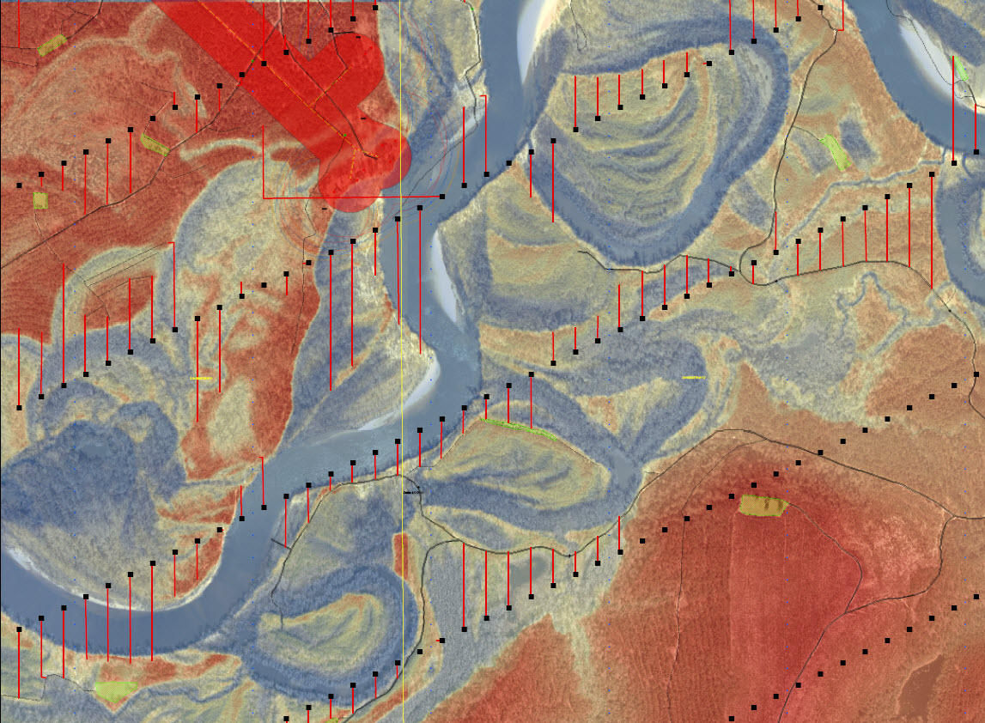
2012 Detailed Lidar/Aerial Preplan
The above image shows the resolution possible from LiDAR overlaying a high
quality aerial photo when focused on a narrow elevation range. Note that
the offset methodology employed does not constrict offsets by bin center in
the normal offset direction, which serves to provide bin scatter and to
randomize the grid.

Slide 13
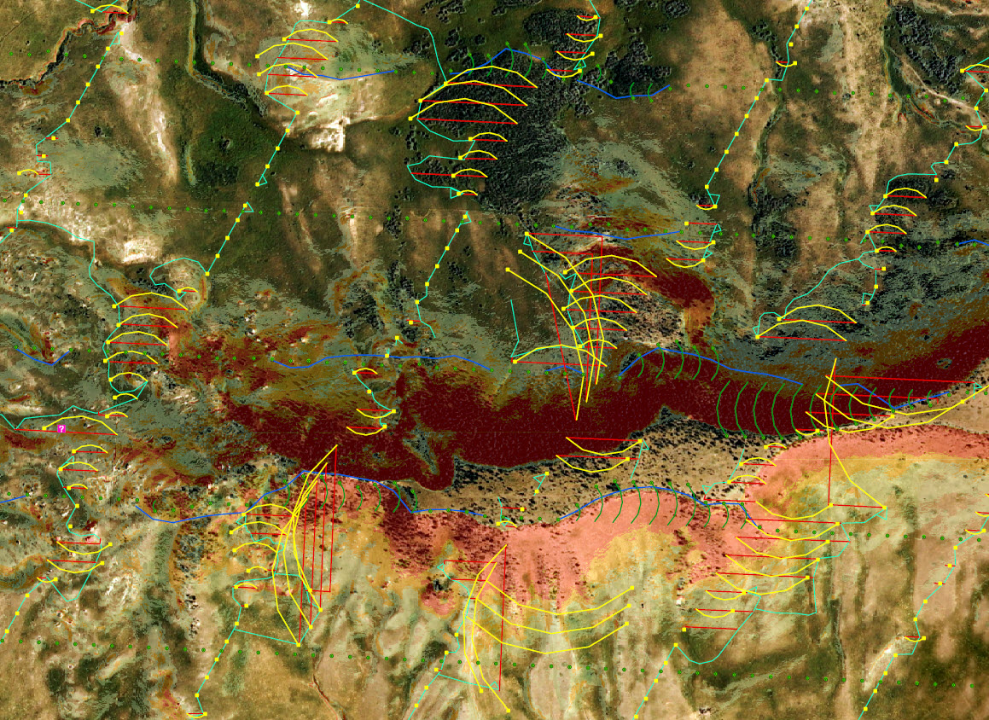
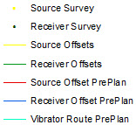

2013 Montana Topo Preplan/Post Plot
This project combined steep topography, strong environmental sensitivities
and a requirement for vibroseis only. Source and receiver designations and
slope color designations are shown on the right hand side of the slide.

Slide 14
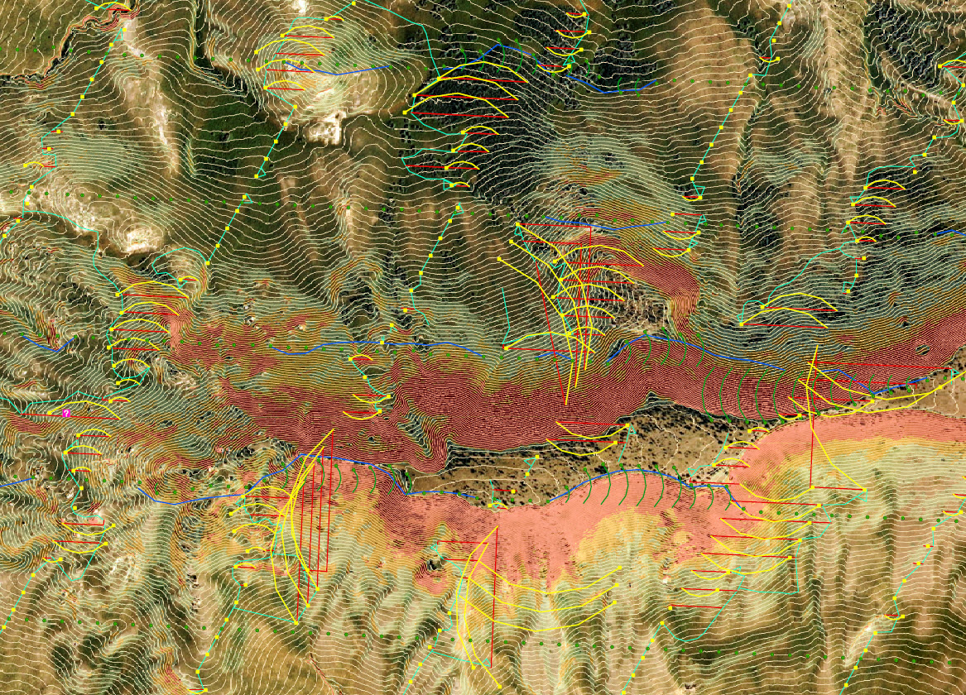
2013 Montana Map With Contours
Contours added to the above map slide.

Slide 15

PPV TESTING & SOURCE DISTANCES
Another very important aspect of quality field geometry is developing “workable” source distance guidelines, based on results of peak particle velocity testing. Workable translates to guidelines that allow one to work close enough to culture and hazards to benefit geometry, while minimizing risks of damage claims and damages. Generally, the source distance guidelines we employ are less than IAGC, although in a few cases they have been considerably greater. The distances are based on evaluations of measured and documented decay of vibration levels with offset distance, with attention to frequencies of the energy, which provides empirical evidence to support the distance guidelines chosen. I can remember very few instances in the last twenty years when one of our clients agreed to pipeline company distance restrictions, which are almost always unreasonably large; ie 300’ to 500’ even with vibrators in situations where one could not harm a pipeline without placing a vibrator pad right on top of it. While these measures might seem risky to some, they are standard operating procedure in our view and have proved prudent.

